Slide 1
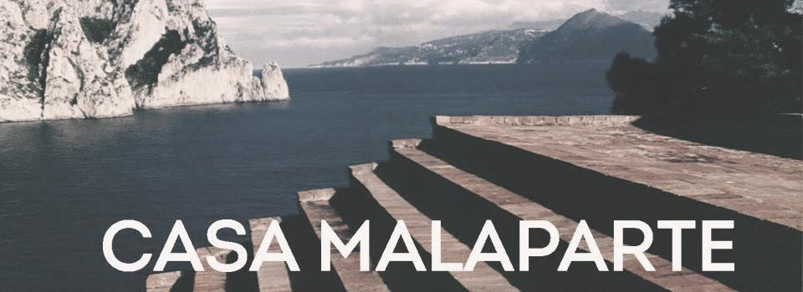
Adalberto Libera's Villa Malaparte
Σύνθεση ΙV
Μαριάννα Τσαγγάρη, Παύλος Πολυβίου, Άντρια Χαριλάου

Slide 2
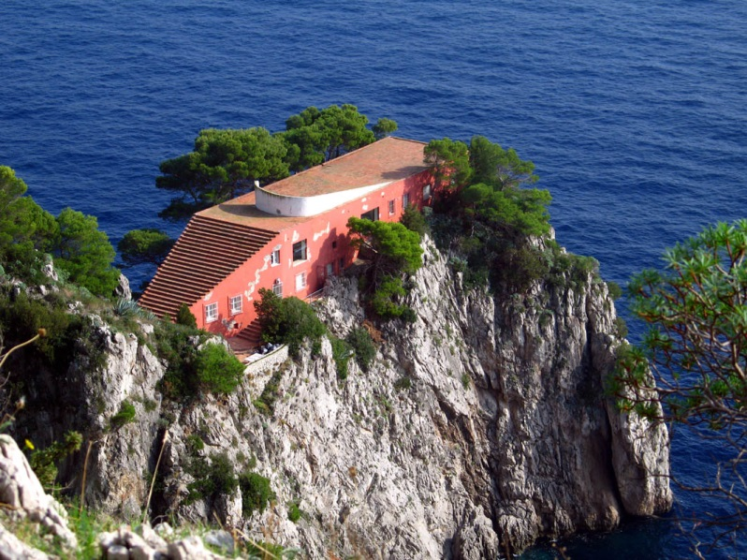
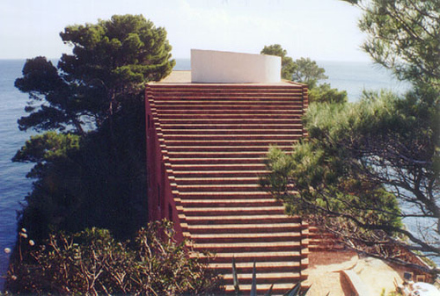
General Information
Villa Malaparte is a house located in the east side of Capri island in Italy.
Designed in 1937 from the architect Adalberto Libera for Courtsio Malaparte who at the end rejected Libera’s design and the house by his self with the help of Adolfo Amitrano.
It is one of the most exemplary and characteristic examples of the Italian modernist era

Slide 3
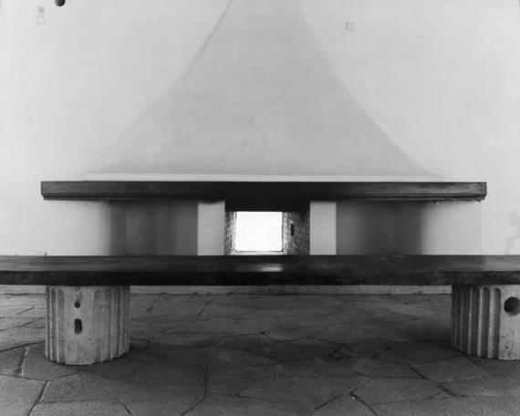

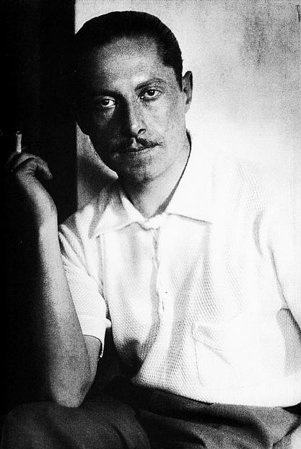
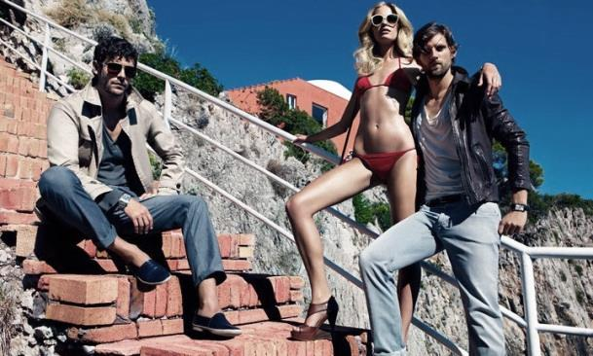
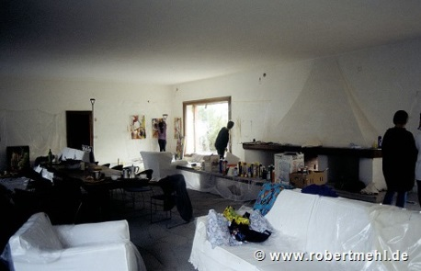


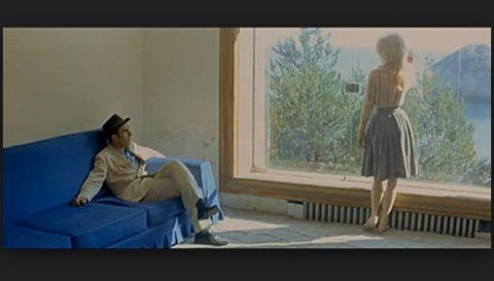
Timeline of Villa Mallaparte
Abandoned
1937
1957
1963
1972
72-80
80-90
2010
Death of
Mallaparte
Villa Malaparte was given in the foundation Giorgio Ronchi

Slide 4
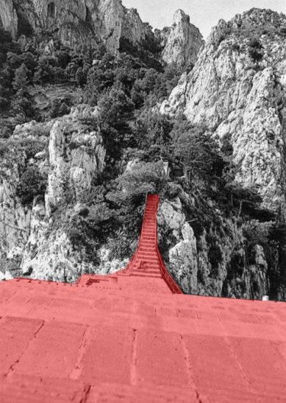
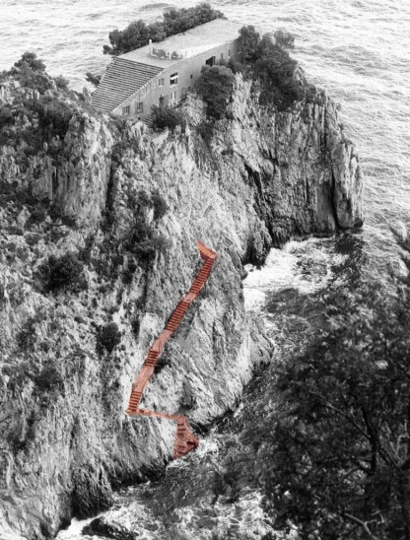
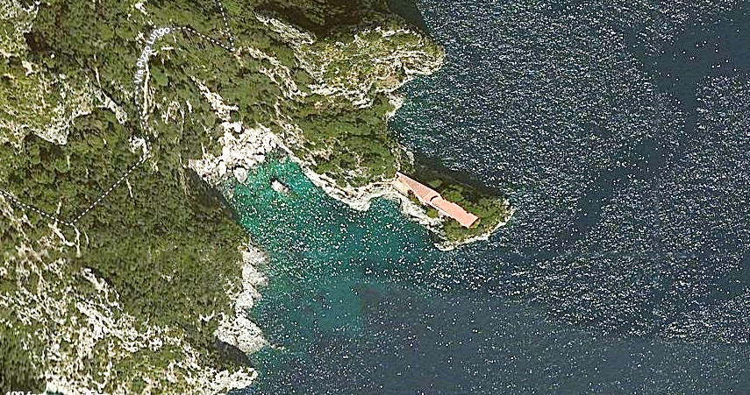
Accessibility
You can reach the house either by walking from the city of Capri or with boat followed by carved steps in the rock
Accessibility from the town
Accessibility from the sea
This picture shows that this house was isolated, which was asked from the user of the house, because he was in jail

Slide 5
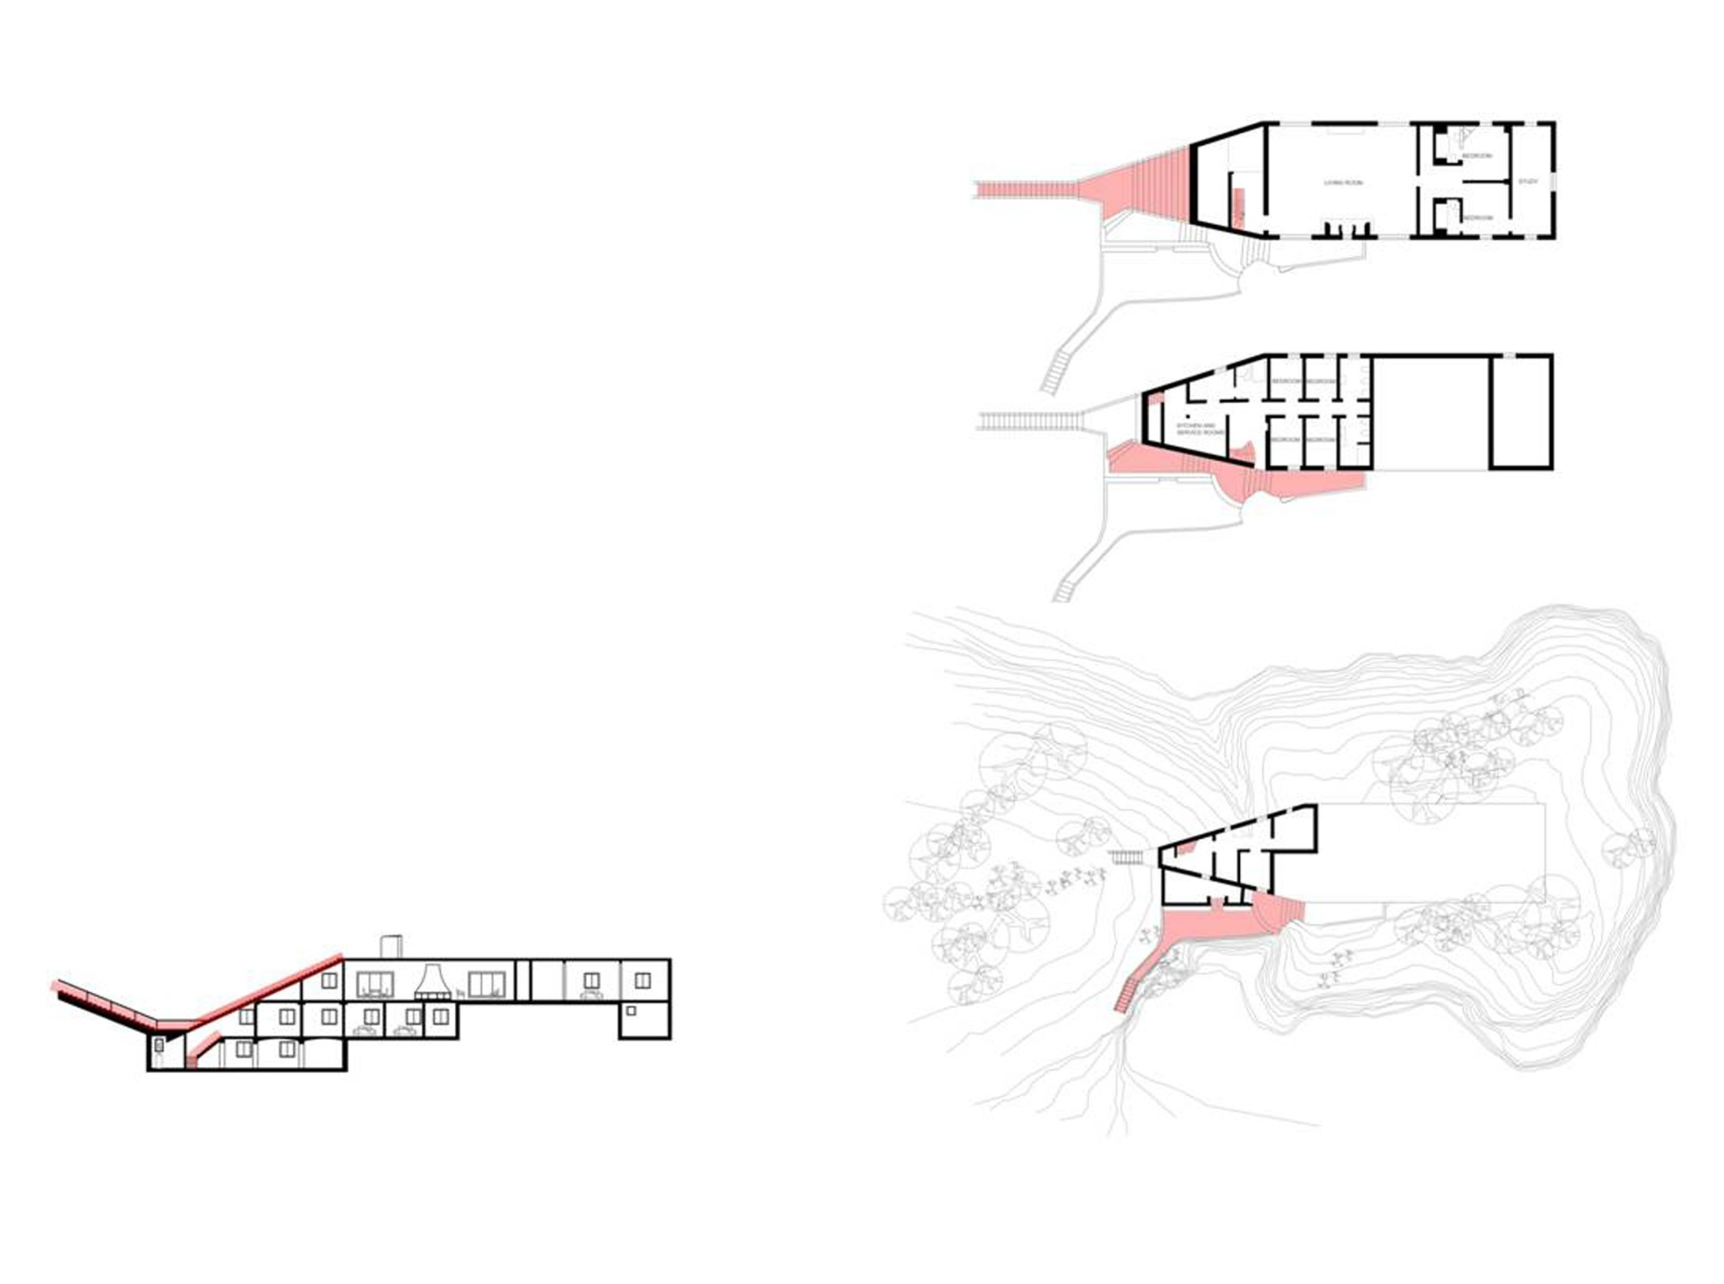
Accessibility in the house

Slide 6
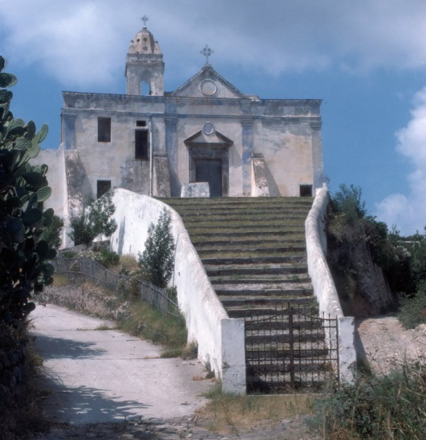
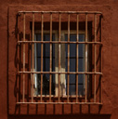
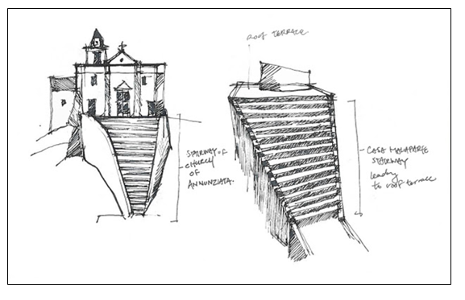
H σκάλα που οδηγεί στην ταράτσα
Κάποια παράθυρα στο κτιριο είχαν την πιο πανω μορφή λογω του ότι ο Μαλαπάρτε πέρασε κάποια χρόνια της ζωής του στην φυλακή.
Εμπνευσμένη από την σκάλα μπροστά από την εκκλησία της Annunziata στο Λίπαρι, το νησί στο οποίο ο Μαλαπάρτε φυλακίστηκε το 1934.

Slide 7
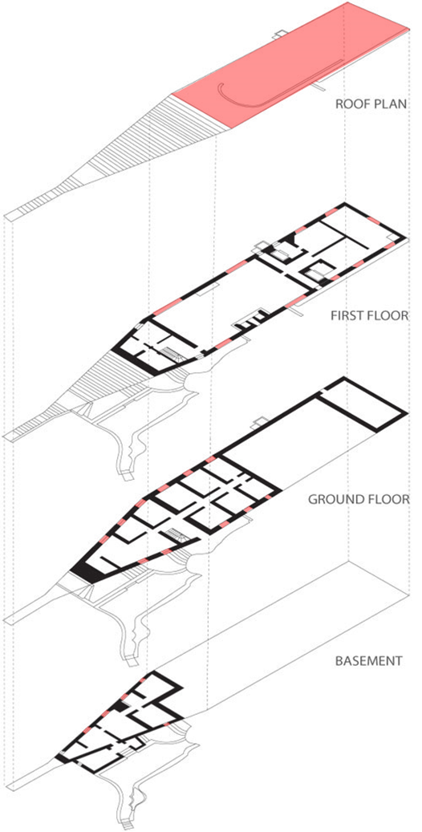
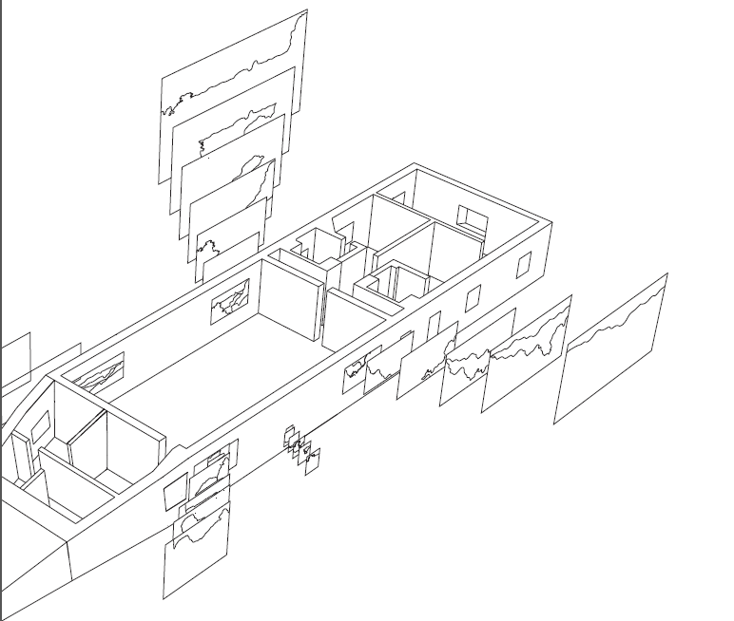
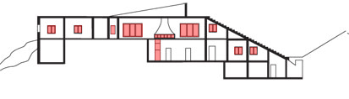
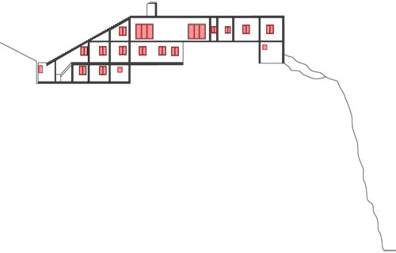
Ορατότητα προς τα έξω

Slide 8
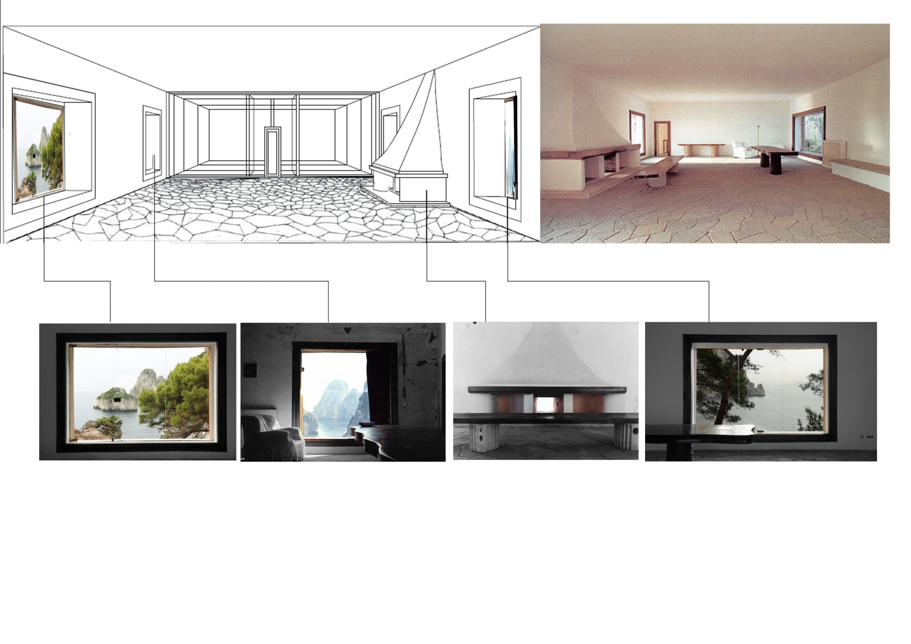
Casa Malaparte incorporates the nature. It does this with the huge size windows with frames reminiscent of paintings where the outside become part of the interior

Slide 9
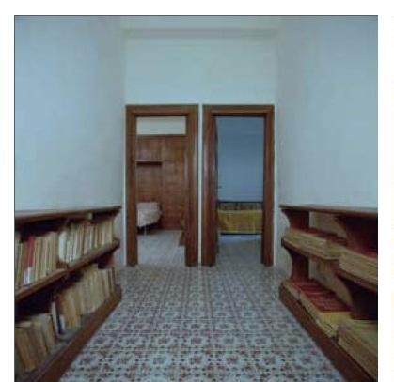

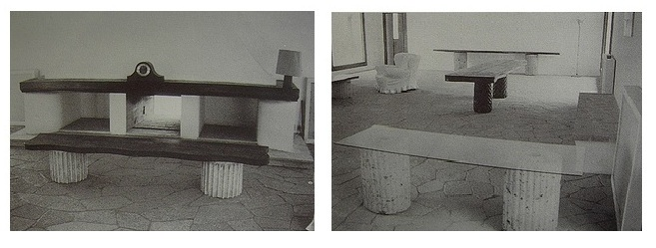
Interior
Malaparte designed also the furniture of the building using fragments of classical architecture of columns and large tree trunks .

Slide 10
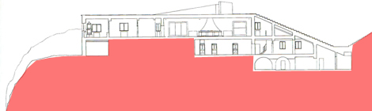
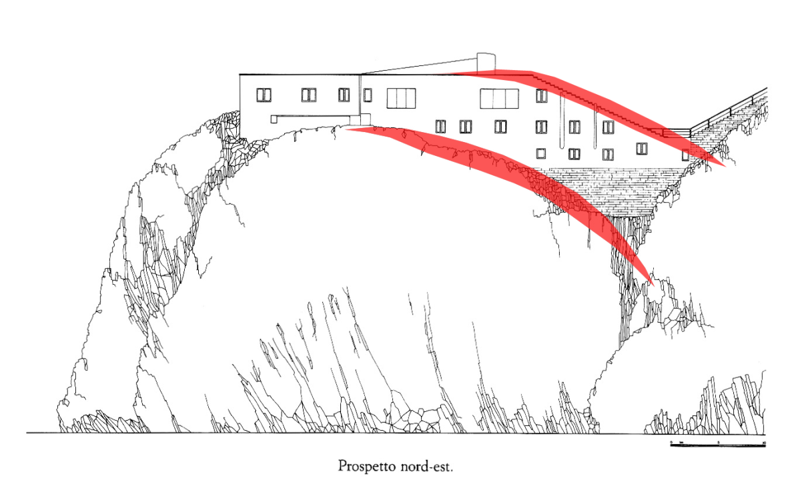
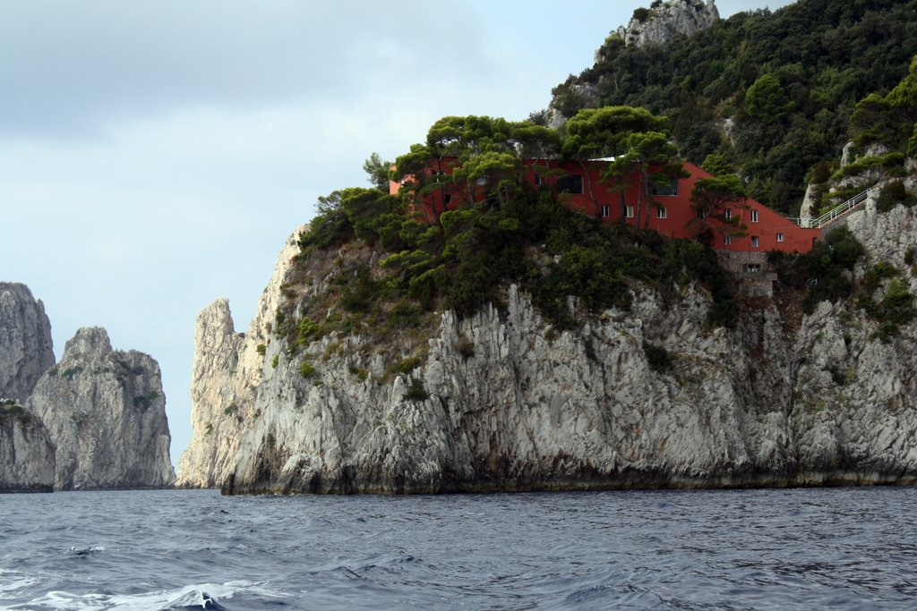
Integration in the landscape
Steep cliff 33 meters
Nearest building in 300 meters →I does not need to match with other buildings
By following the curve of the rock on which is built
Materials: local stone Red →contrast with the color of the rocks and the blue sea

Slide 11
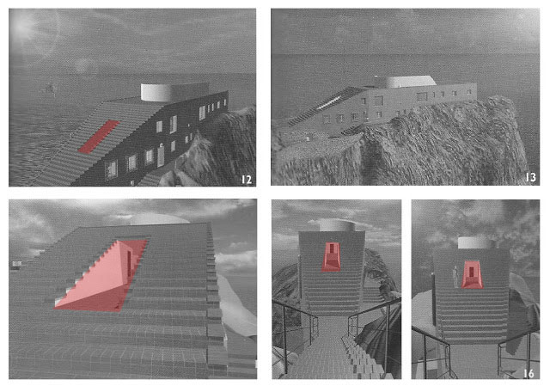
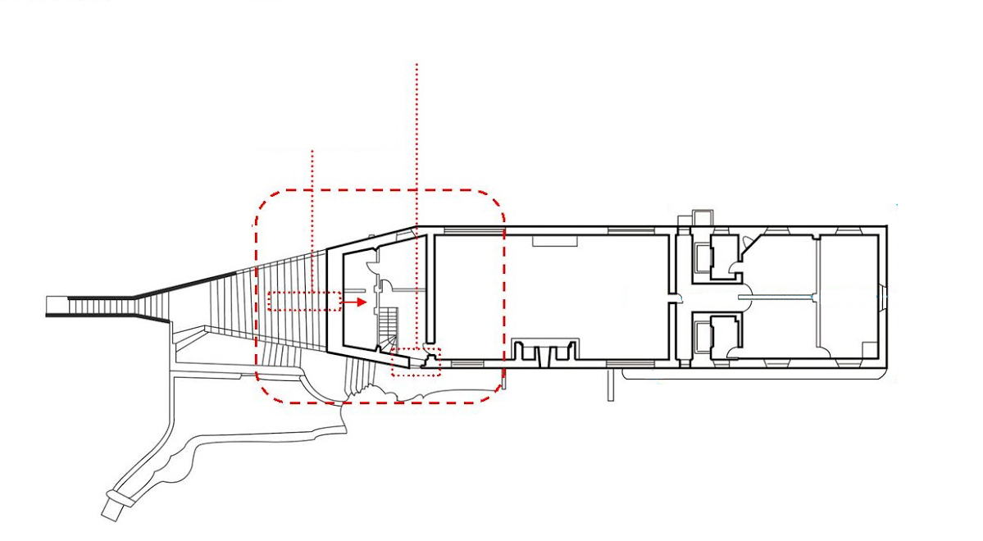
Stairs to the roof
Main access entrance in the middle of high beam due to aesthetic practices the staircase was moved inside of the house. Changing the position of the entrance disturbed the symmetry
Final placement of entrance
Original placement of entrance

Slide 12
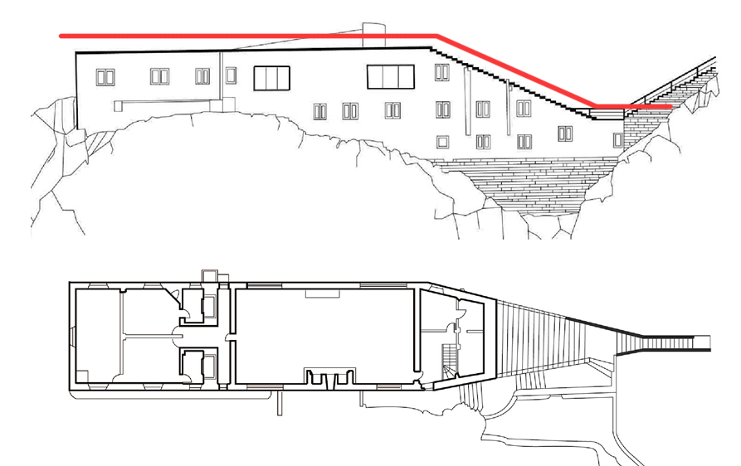
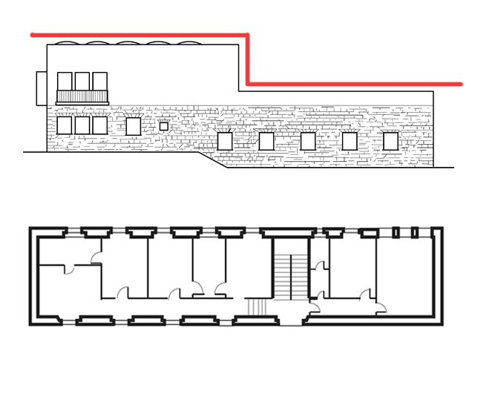
Libera Mallaparte
The rooms aligned along a corridor Evenly
aligned windows
conventional Design
Scattered
Seemingly randomly arranged (large and small windows with bars)
Mirrors personality

Slide 13
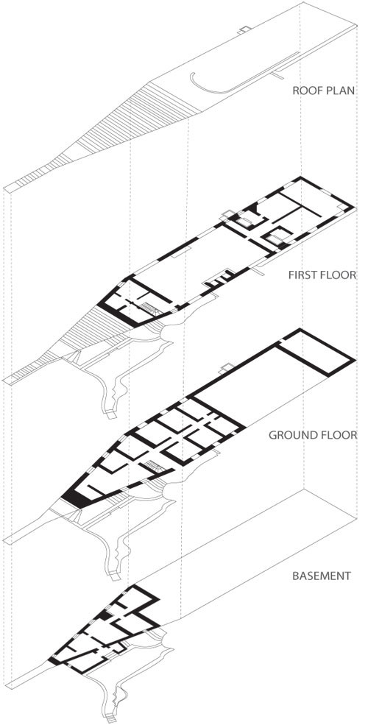
Floor Analysis
On the roof there is a large terrace and a staircase which is perfectly adapted to this part of the rock and resembles an inverted pyramid.
The first floor houses the master bedrooms of which one communicates with a studio , two bathrooms and a collective space , library and reception before the rooms .
The ground floor consists guests rooms with a wood stove Tyrol . In the back is ablated an auxiliary space .
In the basement are additional utility rooms
terrace
Living/ dinning room
Malaparte’s bedroom
bedroom
bathroom
studio
Guest’s room
Utility rooms

Slide 14
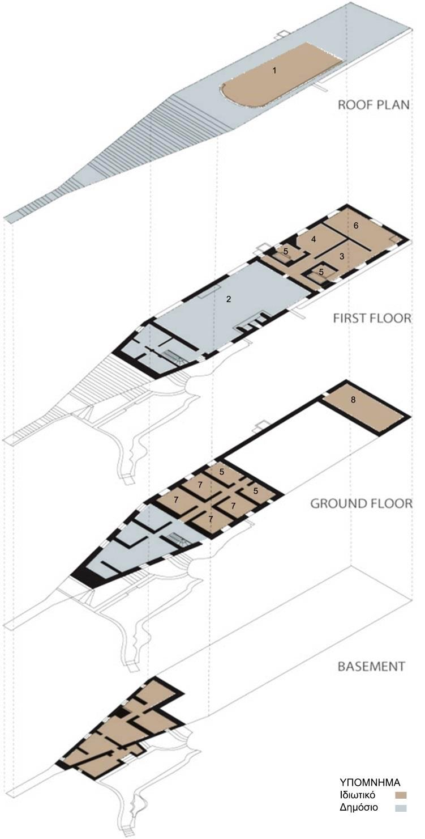
Private - Public and Movement
Free movement on the roof of the house and the wall makes a part of the roof more private .
Emphasizes the public-sharing spaces.
A central corridor -axis divides the ground floor into two, creating symmetry .
The basement utility rooms distributed with asymmetry are separated from the rest house.
Γενικά όλοι οι βοηθητικοί χώροι δεν επικοινωνούν με την όλη κατοικία, διαθέτουν δική τους ξεχωριστή είσοδο.

Slide 15
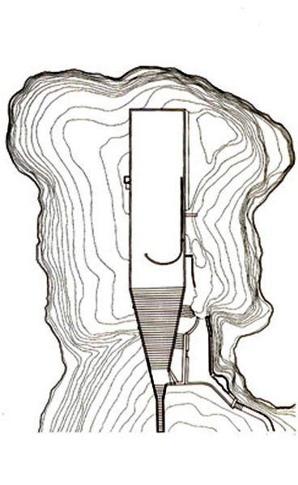
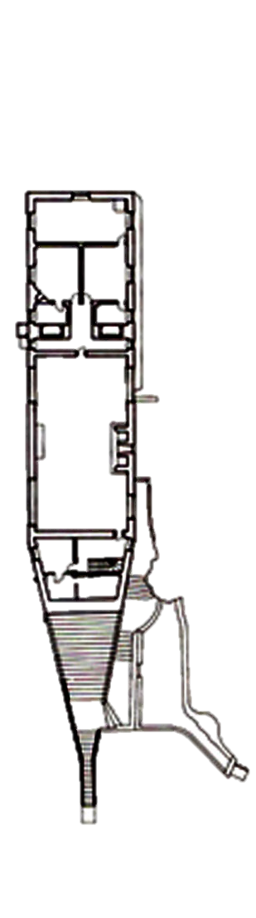
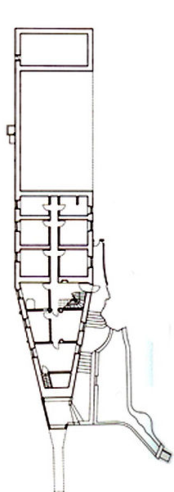
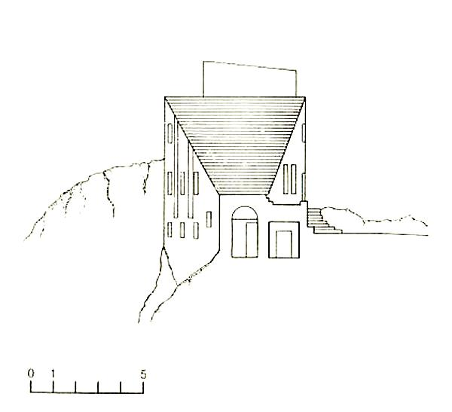
Symmetry of housing
The Symmetry is evident in the exterior of the structure of residence , and internally as shown in plan views of the floor and the ground floor , especially in the bedrooms and toilets .

Slide 16
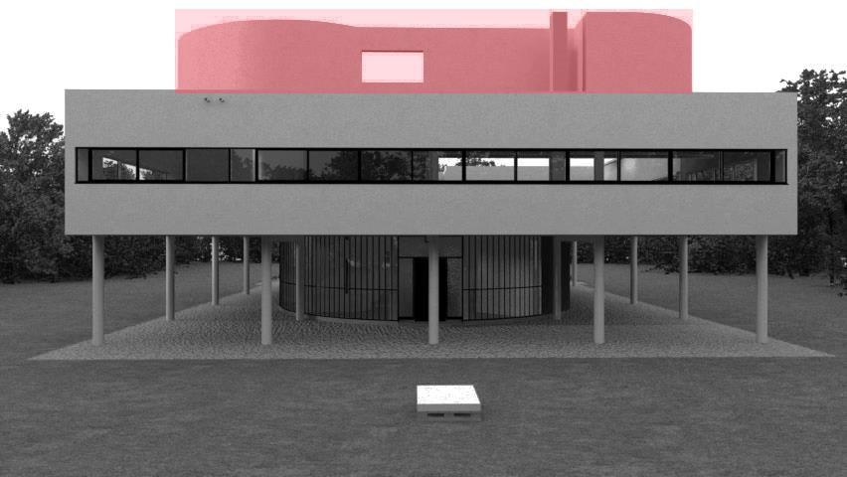
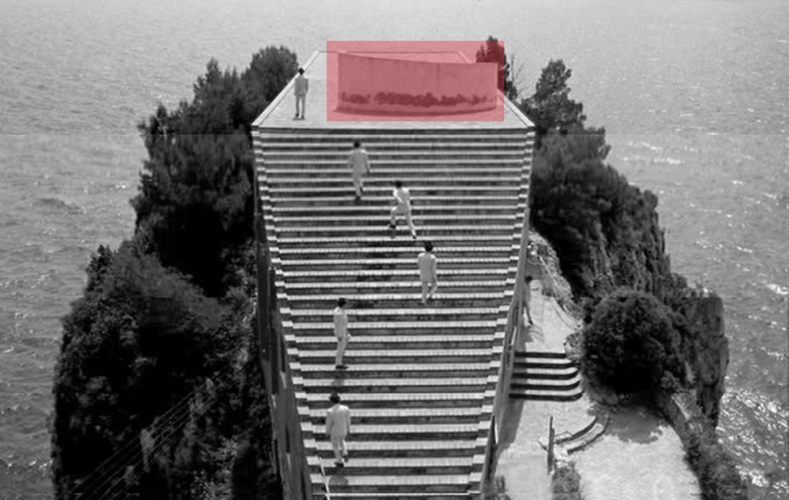
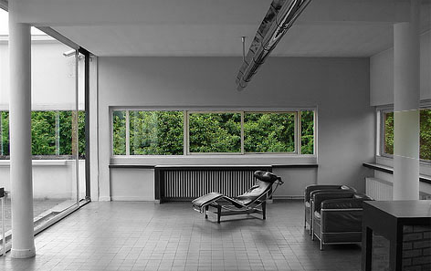
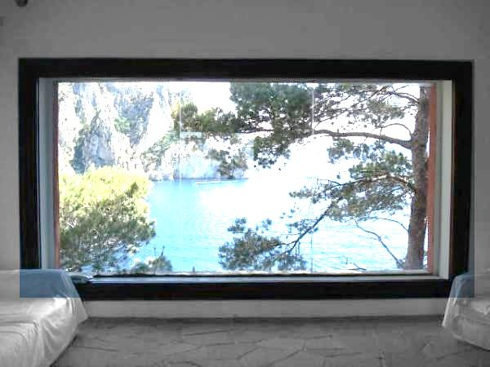
Comparing with Villa Savoye
Villa Savoye, Le Corbusier, France, 1928-1931
Casa Malaparte, Adalberto Libera, Italy, 1937

Slide 17
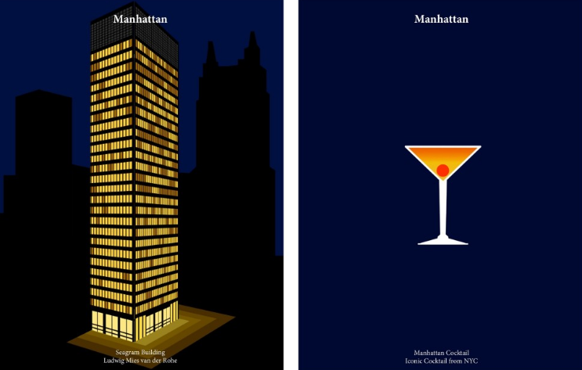
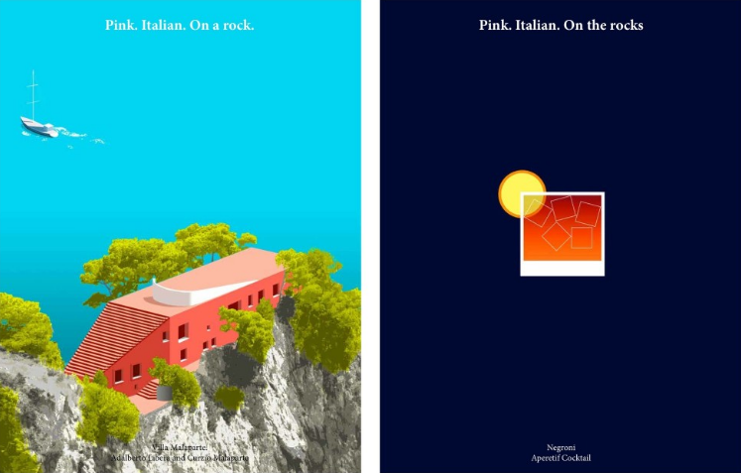
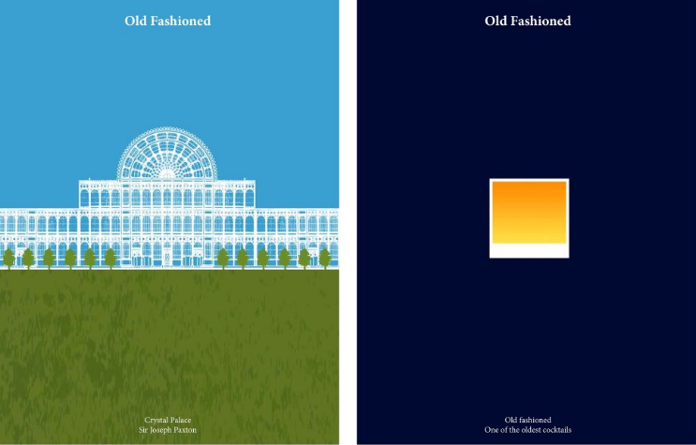
Drink Like an Architect: Pair your Cocktail with the Perfect Building

Slide 18
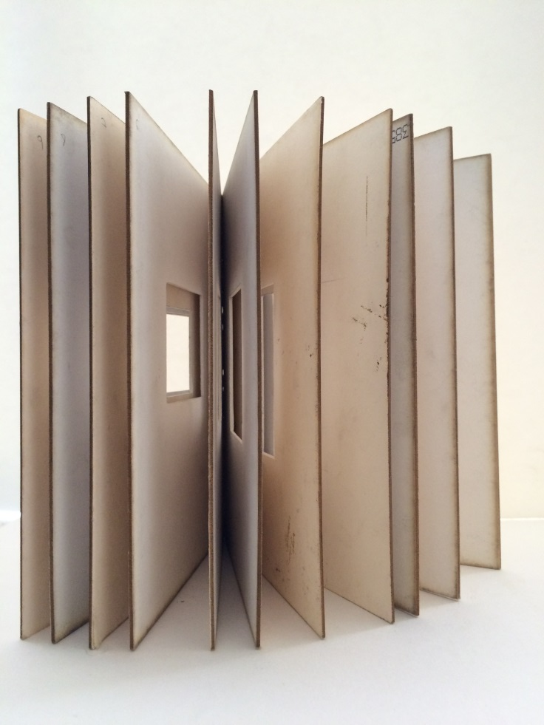
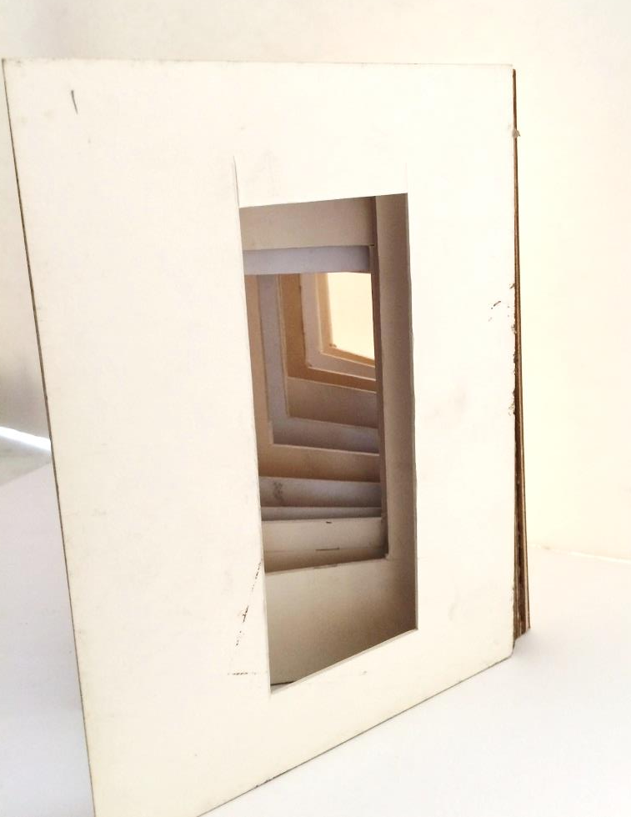
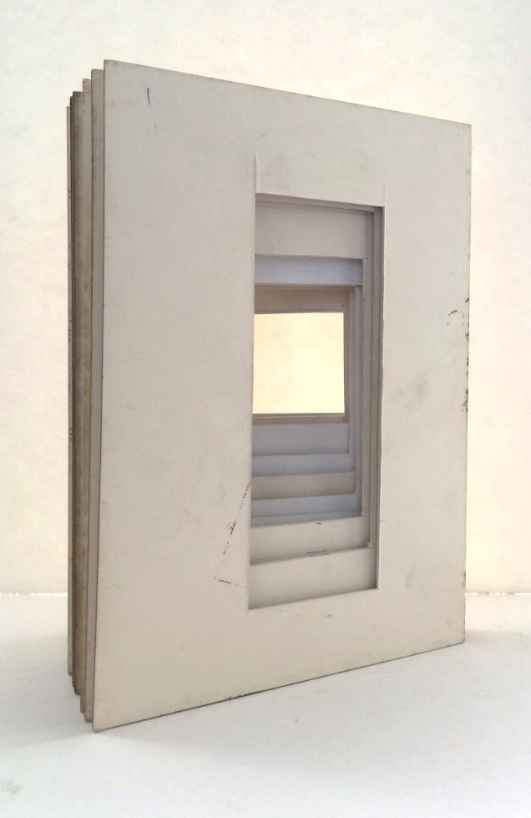
Model Framing

